Slide 1
Weekcode
Tree Month
Week 9: The BFS Queue Problem & The DFS Stack Problem

Slide 2
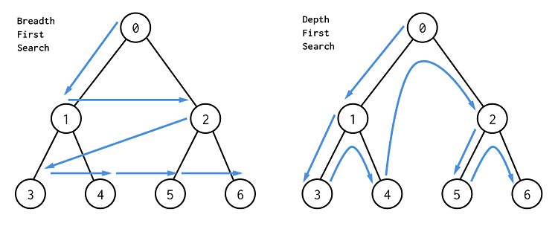
This week’s Tree Concept:
BFS and DFS

Slide 3
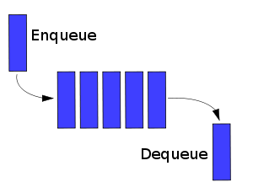
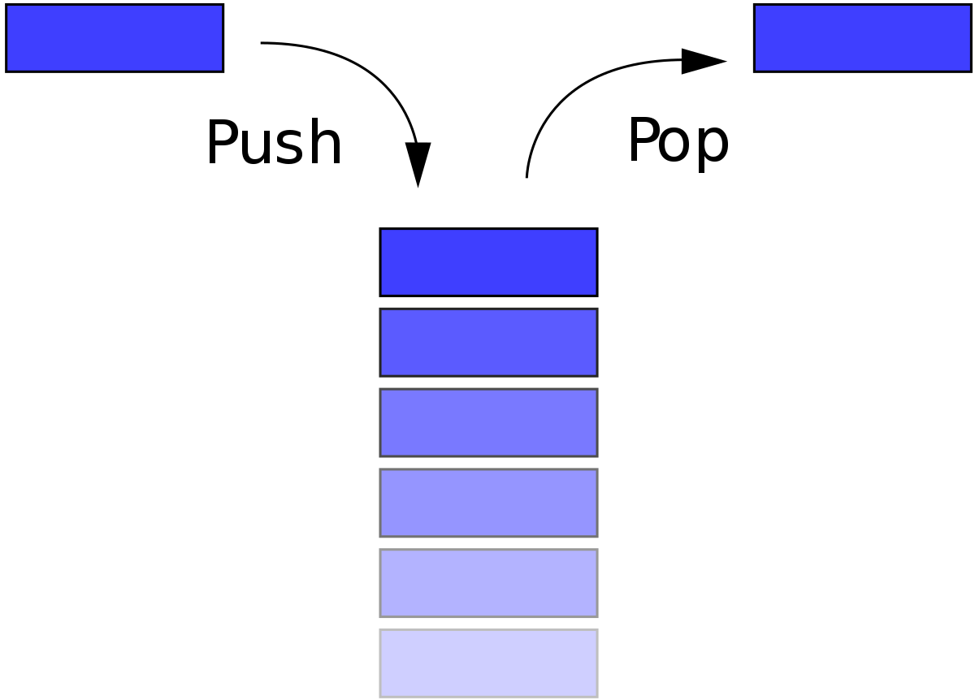
Review of Stacks and Queues
Stack: Last In First Out (LIFO) methodology
Queue: First In First Out (FIFO) methodology
REAR
FRONT
TOP
BOTTOM

Slide 4
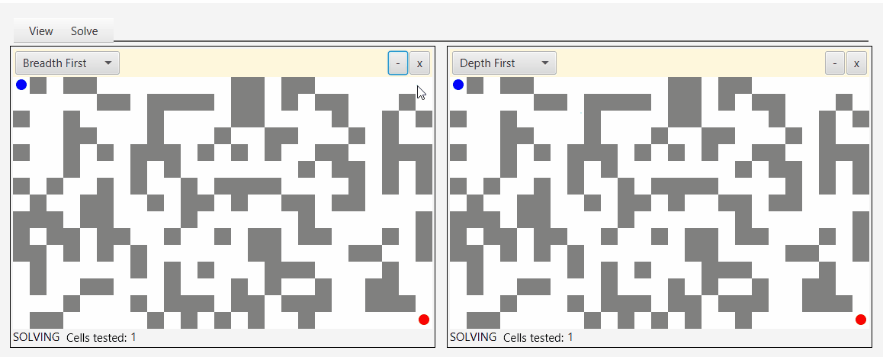
Introduction to BFS and DFS
BFS = Breadth-First Search (Left to Right)[Simplified]
DFS = Depth-First Search (Up and Down)[Simplified]
Both are traversal algorithms to iterate over Nodes in a graph (in our case, Trees)
Either is typically implemented when we want to find a specific Node in a graph or visit all Nodes (traversal)

Slide 5
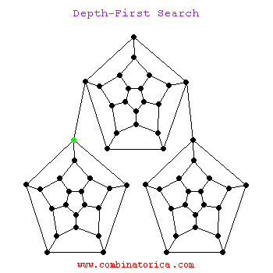

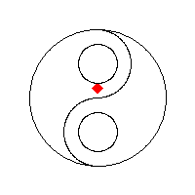
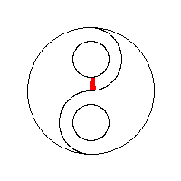
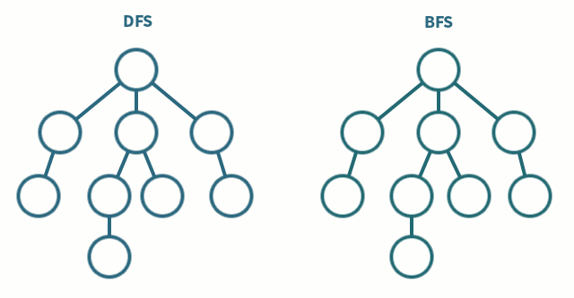
BFS
DFS

Slide 6
BFS and Queues
In BFS, all Nodes of a Level are visited before any Node of the descending Level (recall from the previous presentation)
Logically then, it makes sense to store Nodes in Queueing order, because:
Queues will store index integrity while traversing Nodes per Level (by breadth, in other words)

Slide 7


Slide 8
BFS Implementation:
BFS is only concerned with per-Level indexing
Thus, when we reach the rightmost Node of any Level, we must deque our entire queue to keep the traversal order accurate (this becomes our “visited” list)
Therefore, by the FIFO nature of Queues, we remove the leftmost Node of the current Level up until we remove our rightmost Node
Then, we begin again at the new Level, adding the leftmost Node first. Once we reach the rightmost Node, our leftmost Node will be at the very front of the Queue, and as such, will be dequeued first (remember: FIFO)

Slide 9
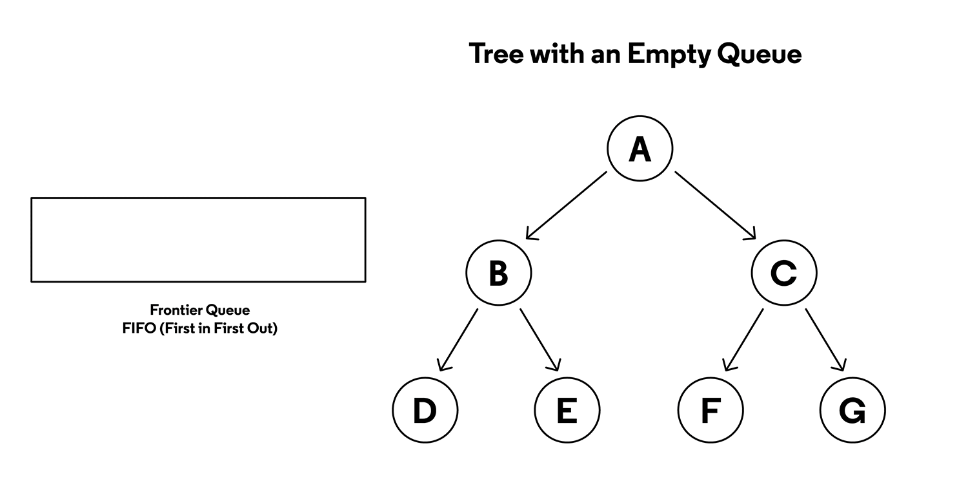

Slide 10
DFS and Stacks
In DFS, we travel down the leftmost Nodes from some starting Node, per subtree
Once we reach the left leaf of some subtree, we travel back up to our root, go down the right subtree (if there is one), sticking to the left side of that subtree if there is a left side
We continue this until the rightmost Node of the rightmost subtree is visited (in other words, the rightmost leaf of lowest Level)

Slide 11


Slide 12
DFS Implementation:
DFS is only concerned with reaching Leaves as quickly as possible
Therefore, DFS is commonly implemented using Pre, In, or Post Order Traversal. Of the 3, Inorder Traversal is most common
Using a stack for any of these traversal orders is appropriate. This is because of the LIFO nature of stacks meshes with the DFS method of traveling as far down a branch as you can go, and then backtracking (pushing and then popping)

Slide 13
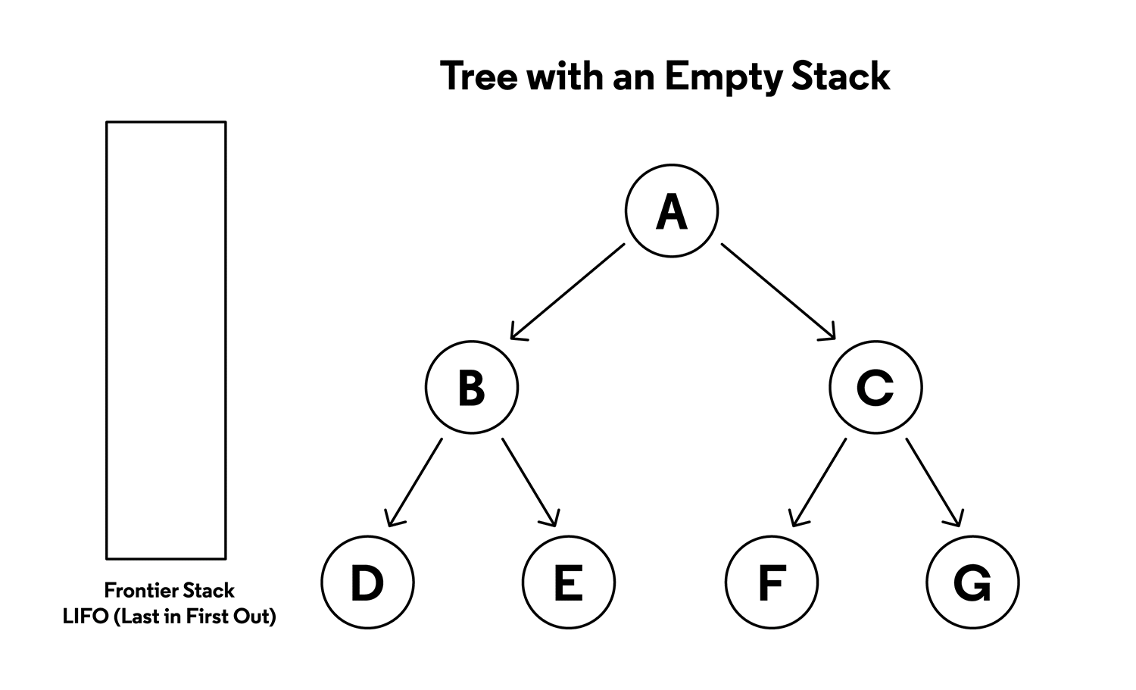

Slide 14

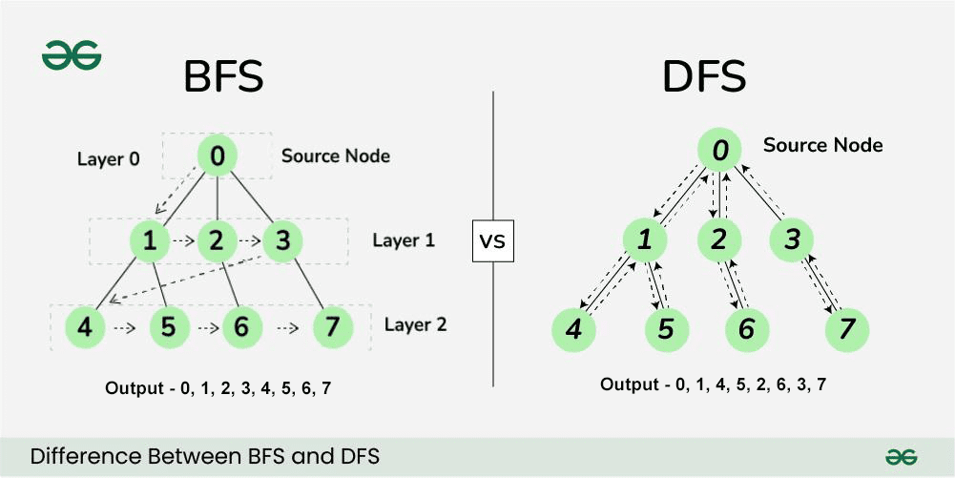
Weekcode Challenge #18:
The BFS Queue Problem
You are given a Tree with populated Nodes. Your job is to print the entire contents of the Tree using BFS and Queues. Only implementation of BFS using Queues is valid

Slide 15
Weekcode Challenge #19:
The DFS Stack Problem
You are given a Tree with populated Nodes. Your job is to print the entire contents of the Tree using DFS and Stacks. Only implementation of DFS using Stacks is valid

Slide 16

Looking Ahead
Good luck!
Tree Month will persist for all of April
Next week: Min and Max Heaps

